Slide 1
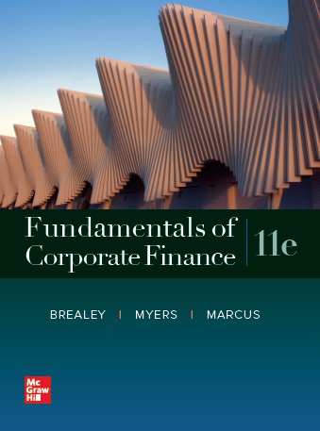
Fundamentals of Corporate Finance, 11th Edition
CHAPTER 5: The Time Value Of Money
© McGraw Hill LLC. All rights reserved. No reproduction or distribution without the prior written consent of McGraw Hill LLC.

Slide 2
Annuities/Loans, see Excel
Loans are Annuities
Review payments, Loan Amount (PV), principal vs. interest
i vs. r
Value Destruction, Value Creation

Slide 3
Annuities/Loans, see Excel
Loan Balance; how much (principal) do I owe?:
PV of remaining payments discounted at contractual rate of interest
Excel

